Slide 1
Doing Neuroscience with Python
Javier Turek (javier.turek@intel.com)
BrainIAK Hackathon
PNI, July 18th, 2016

Slide 2
Typical Neuroscience Workflow
nibabel, nilearn
Read fMRI data
Preprocessing
Analyze (machine learning, statistics)
Visualize results
Save the results
Note: there is some overlap between libraries.
nipype, nilearn
scikit-learn,
BrainIAK, pyMVPA
matplotlib, nilearn

Slide 3

nibabel
Read and write many of the data formats used in neuroimaging:
NIFTI
DICOM
MINC
ANALYZE
Freesurfer geometry
nibabel.load()

Slide 4
nipype
Provides interfaces to many existing neuroimaging processing and analysis packages:
SPM
FreeSurfer
FSL
AFNI
ANTS
Camino
Slicer
And more…
Nice tutorial for nypipe: http://miykael.github.io/nipype-beginner-s-guide/nipype.html

Slide 5

Provides tools and interfaces to do neuroimaging and machine learning (with scikit-learn) in python.
Reading a dataset
Read nifty files
Applying mask
Plotting brain images
Easy to connect to scikit-learn
Many contributors to this project are involved in scikit-learn, too.

Slide 6

A library for applying Machine Learning algorithms
Classification: SVM, Log. Reg, NN, random forest, …
Regression: SVR, Ridge Reg., Linear Reg., LASSO, …
Clustering: k-Means, spectral clustering, …
Dimensionality Reduction: PCA, feature selection, NNMF, …
Model selection: CV, Grid search, metrics

Slide 7
Basic classes in scikit-learn:
Estimator: fits a model with training data (e.g., training SVM)
fit()
Predictor: computes a prediction for testing data (e.g., testing SVM)
predict()
Transformer: transform data (e.g., dimensionality reduction)
transform()
Model: a model that gives a goodness of fit measure for unseen data (e.g., SVM)
score()

Slide 8
To use an algorithm in scikit-learn:
Create an instance of a class with the algorithm parameters: svm = SVC(kernel=‘linear’)
Call the activation function with the data as parameters: svm.fit(train_data, labels) prediction = svm.predict(test_data)
Check the results: accuracy = (prediction == target).sum() / len(target)

Slide 9

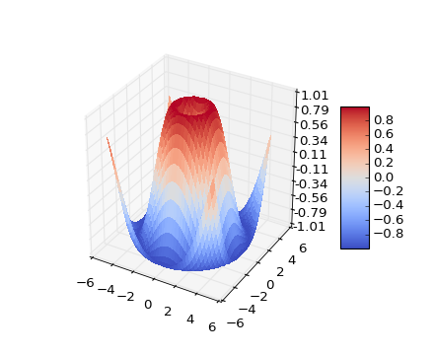
A library for ploting graphs
Based on Matlab functions:
Create a figure with figure()
Plot using plot()
Add title with title()
Add axis labels with xlabel() and ylabel()
…
Eventually, use show() to show it.
TeX rendering support
TIP: If you want a plot inside a notebook add %matplotlib inline

Slide 10
Let’s Try This!
Go back to the example notebook and do this:
Change the cross-validation scoring to f1 and see how the weights change
Change the classifier by Logistic Regression (L1-regularized) and see the weights
Create a Pipeline object that applies feature selection before classifying with SVM. (Try it for one fold and then for CV). Visualize the weights of the overall pipeline.
Repeat the experiment but with all the image types in the labels (remove ‘rest’). Use a Nu-SVM (multiclass classifier) for classifying.
Apply the SUSAN filter (nipype) to the Haxby dataset.

